Slide 1

Wellcome To ONLINE FOOD ORDERING SYSTEM Balisetti Revathi Aixsb1017.

Slide 2
Introduction
ONLINE FOOD ORDERING SYSTEM is a website designed primarily for use in the food delivery industry. This System will allow hotels and restaurants to increase scope of business by reducing the cost involved.
The System also allows to quickly and wasily manage an online menu which customers can browse and use to place orders with just few clicks. Restaurant employes then use these orders through an easy to navigate graphical interface for efficient processing.

Slide 3
Modules
User Module
Admin Module
Food Category
Search Module

Slide 4
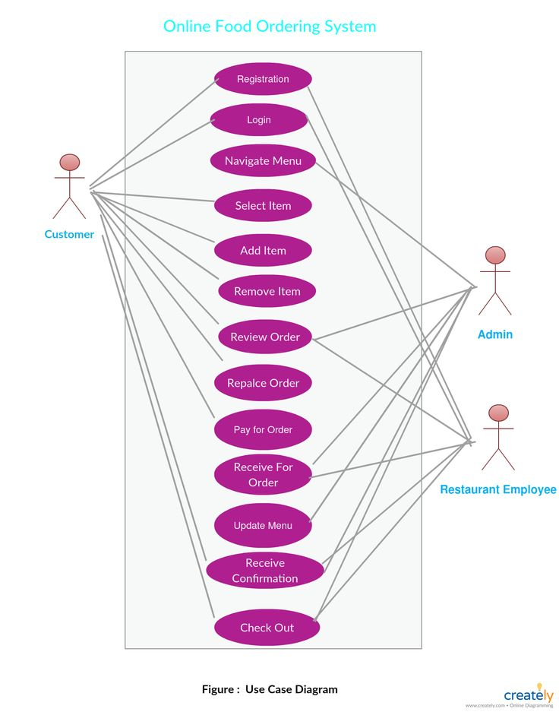
ER Diagram

Slide 5
System Working
Admin Side:
Signup and login to the App.
Select item from food category.
Then Added and updated and remved the food here.
User Side:
Create an Accout.
Manage Their Account.
Login in to the System.
Select menu from Food category .
Add an item to their Cart.

Slide 6






Tools Used

Slide 7
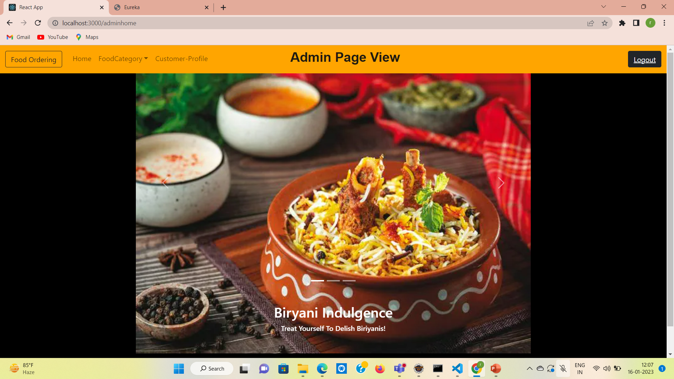
Admin Home

Slide 8
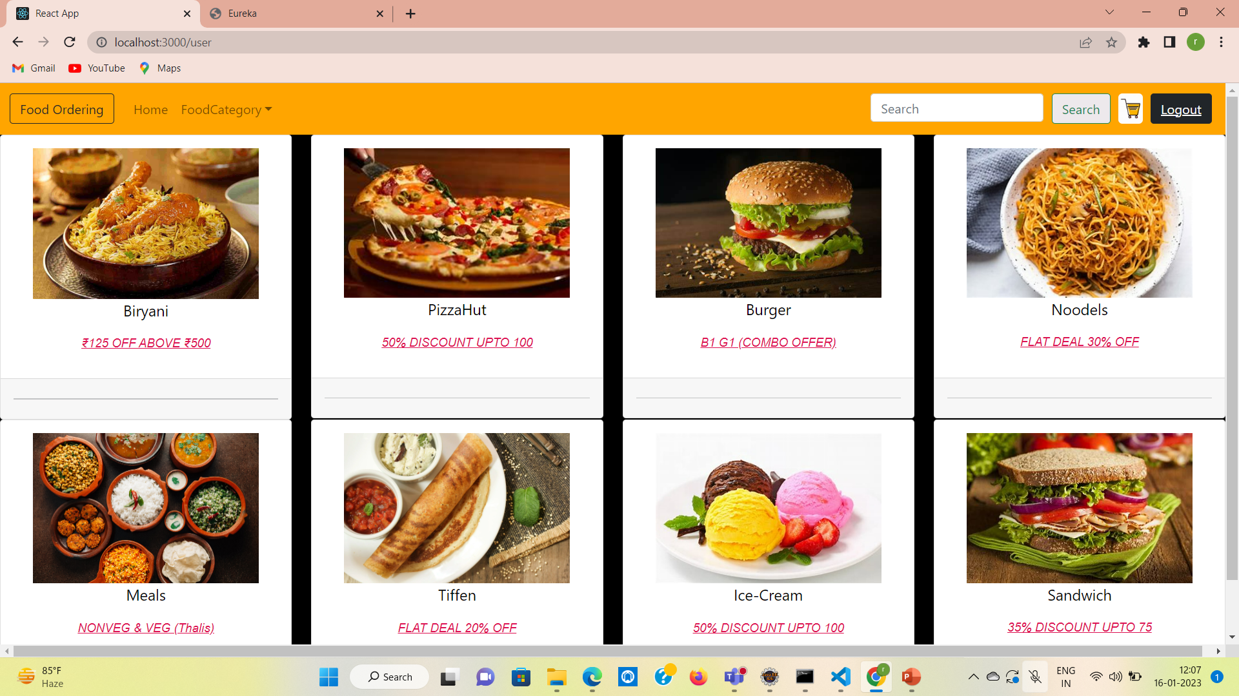
USER Home

Slide 9
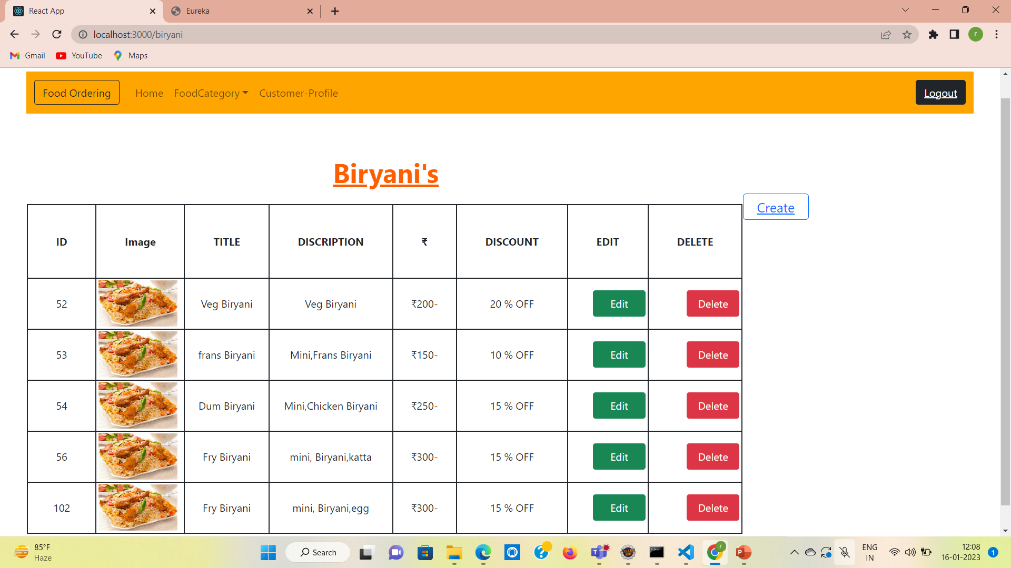
Admin Actions

Slide 10
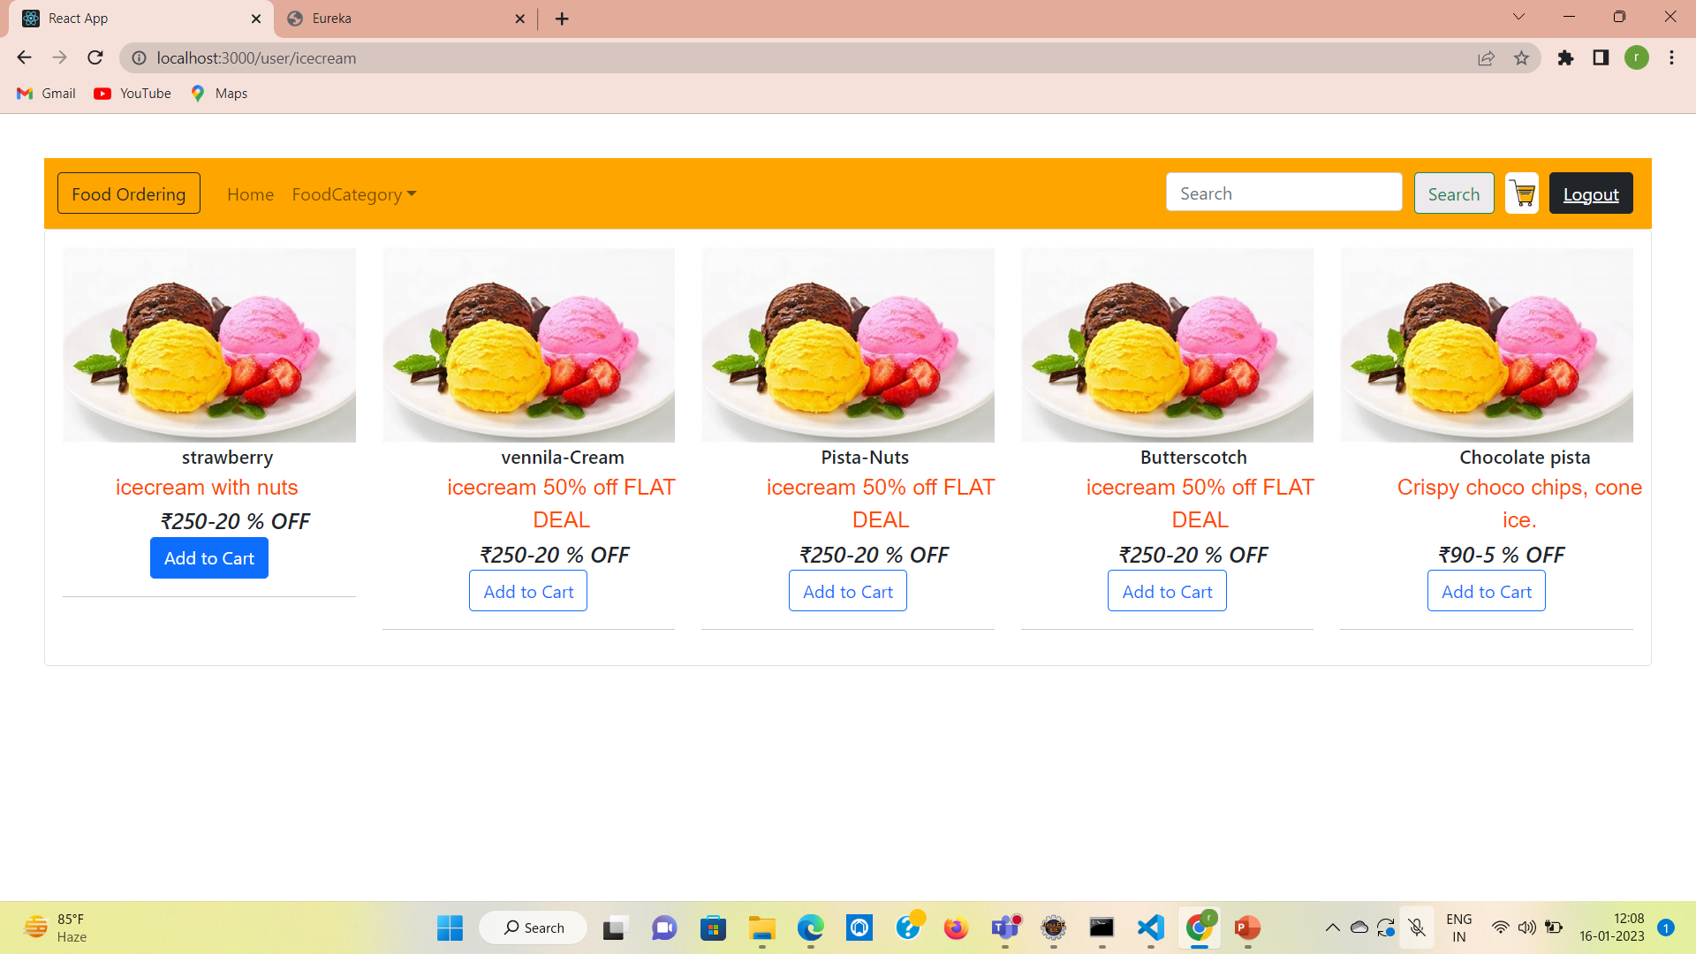
User Actions

Slide 11
THANK YOU

